Slide 1

Project Title - Seasonal Agriculture performance analysis
[Student Name- Mayank Pawar
College Name- Samrat Ashok Technological Institute Vidisha ,MP]
AICTE STU ID : STU6a66c3b0386341785119664

Slide 2

PROBLEM STATEMENT
(Agricultural activities are influenced by seasonal variations in environmental conditions, farming practices, resource availability and market conditions. As a result, agricultural performance may differ from one season to another. However, raw agricultural data does not clearly explain how agricultural performance changes across seasons or what patterns can be observed in different seasonal conditions. The problem is to analyze the given agricultural dataset and investigate seasonal differences in agricultural performance by identifying meaningful patterns, trends, relationships and variations within the available data.

Slide 3
Project Description This project focuses on analyzing agricultural performance across different seasons, crops and regions using data analytics techniques.
The analysis includes data cleaning, exploratory data analysis, seasonal comparison, crop and regional analysis, environmental conditions, resource usage, water efficiency, economic performance and disease/pest risk.
Statistical and visualization techniques are used to identify meaningful patterns, relationships and variations in agricultural performance and to develop evidence-based insights for better seasonal agricultural planning.

Slide 4

WHO ARE THE END USERS?
Farmers – for better seasonal and crop planning
Agricultural Planners – for evidence-based agricultural planning
Agricultural Researchers – to study seasonal patterns and trends
Government Agricultural Departments – for planning and resource management
Agribusiness Organizations – to understand crop and seasonal economic performance

Slide 5

Technology Used
Python
Pandas
NumPy
Matplotlib
Seaborn
SciPy
Google Colab
GitHub

Slide 6
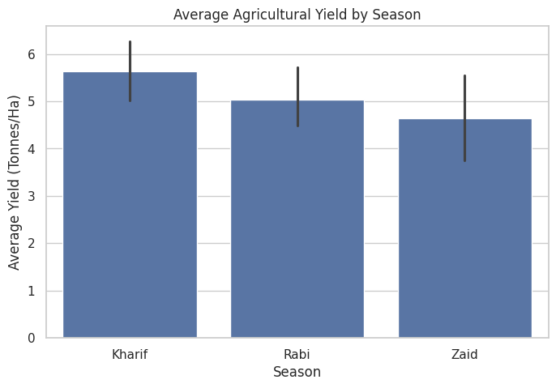
RESULTS
Observation:
Kharif recorded the highest average yield.
Zaid recorded the lowest average yield.
Yield varies across seasons.

Slide 7
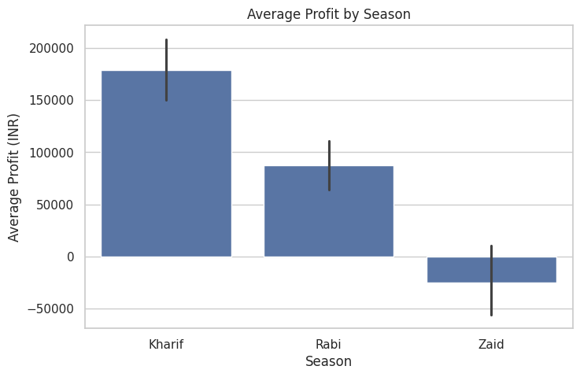
RESULTS
[plt.figure(figsize=(8,5))
sns.barplot(
data=df,
x='Season',
y='Profit_INR',
estimator='mean'
)
plt.title('Average Profit by Season')
plt.xlabel('Season')
plt.ylabel('Average Profit (INR)')
plt.show()
]
Short Observation:
Kharif shows the strongest performance.
Rabi performs below Kharif.
Zaid shows the weakest average profitability.

Slide 8
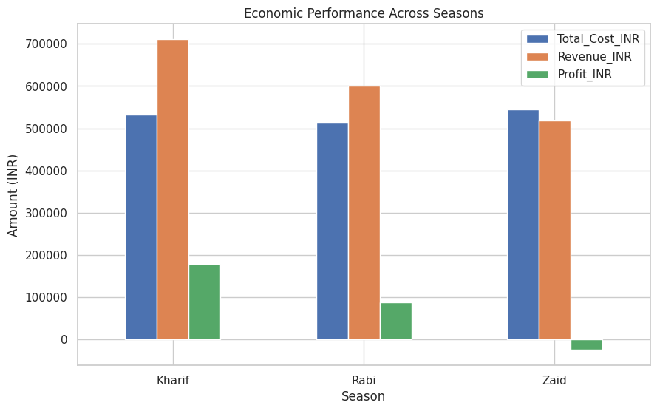
RESULTS
[economic_summary = df.groupby('Season')[[
'Total_Cost_INR',
'Revenue_INR',
'Profit_INR'
]].mean()
economic_summary.plot(
kind='bar',
figsize=(10,6)
)
plt.title('Economic Performance Across Seasons')
plt.xlabel('Season')
plt.ylabel('Amount (INR)')
plt.xticks(rotation=0)
plt.show()
]
Short Observation:
Kharif shows the strongest average economic performance.
Rabi performs below Kharif.
Zaid shows the weakest average profitability.

Slide 9
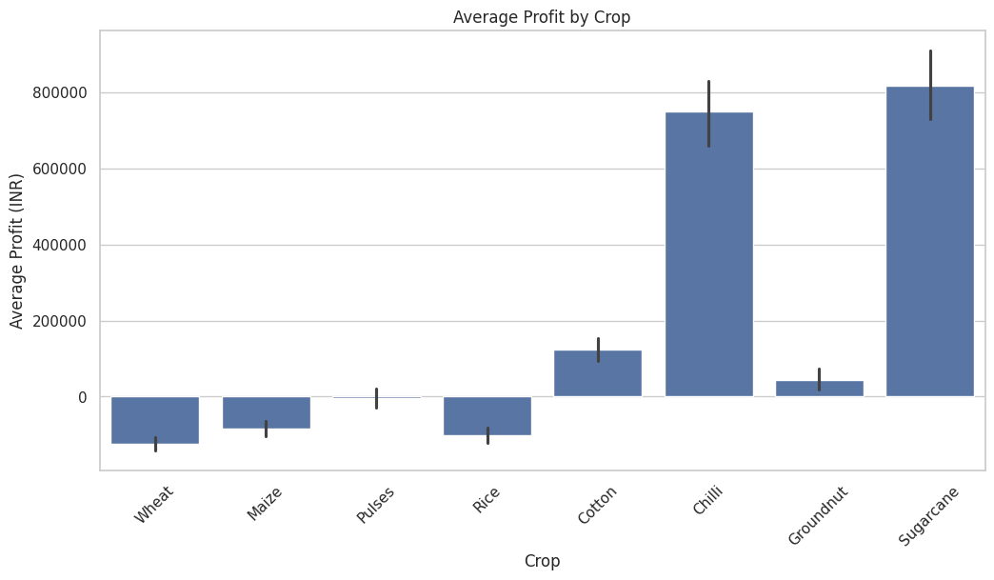
RESULTS
[plt.figure(figsize=(12,6))
sns.barplot(
data=df,
x='Crop',
y='Profit_INR',
estimator='mean'
)
plt.title('Average Profit by Crop')
plt.xlabel('Crop')
plt.ylabel('Average Profit (INR)')
plt.xticks(rotation=45)
plt.show()
]
Short Observation:
Sugarcane has the highest average profit.
Chilli is the second-highest profitable crop.
Several crops show negative average profitability.

Slide 10
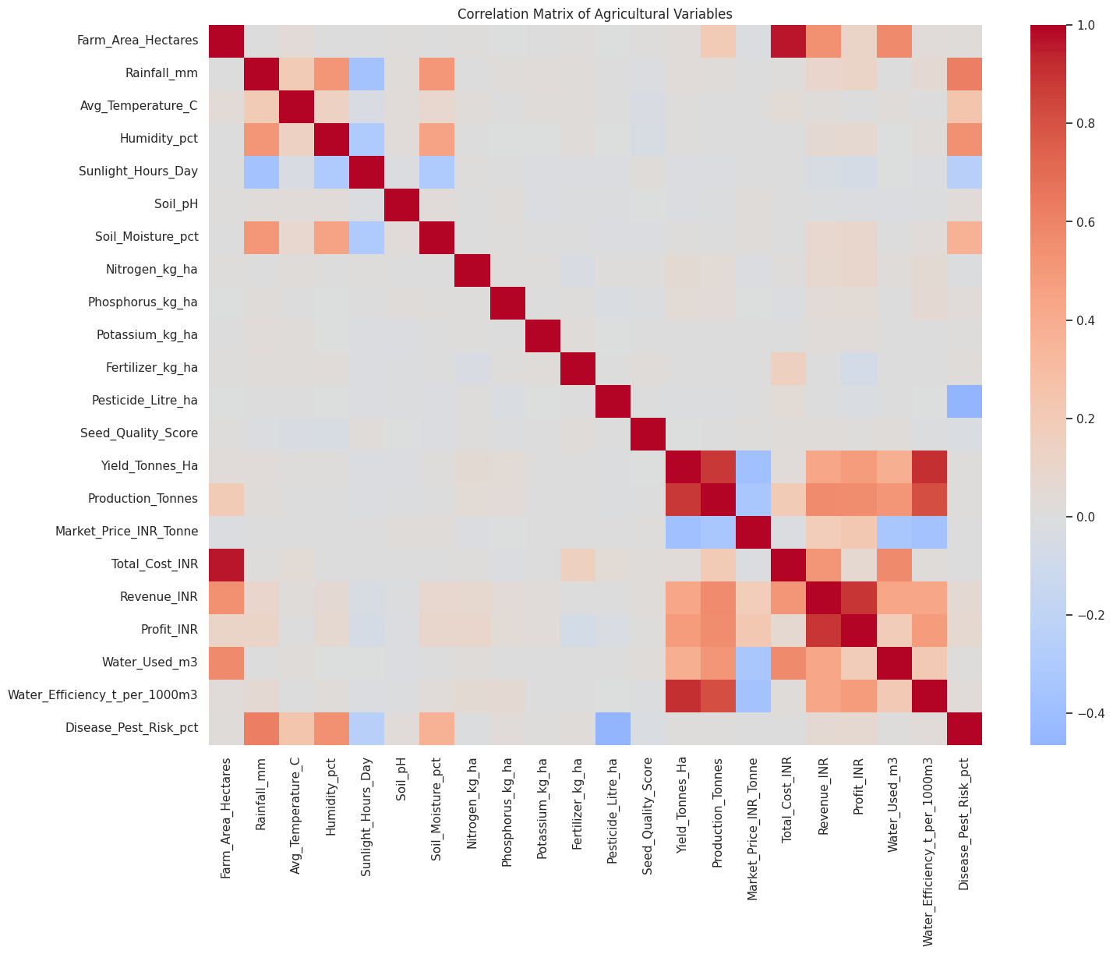
RESULTS
[numeric_df = df.select_dtypes(include=np.number)
correlation = numeric_df.corr()
plt.figure(figsize=(16,12))
sns.heatmap(
correlation,
cmap='coolwarm',
center=0
)
plt.title('Correlation Matrix of Agricultural Variables')
plt.show()
]
Short Observation:
Yield and water efficiency show a strong positive relationship.
Revenue has a strong positive relationship with profit.
ANOVA indicates significant differences in average profit across seasons.

Slide 11
Future scope
Predictive Analysis: Develop models to predict future agricultural yield and profitability.
Weather Integration: Incorporate historical and real-time weather data for better seasonal analysis.
Crop Recommendation: Develop a system to recommend suitable crops based on seasonal and environmental conditions.
Risk Prediction: Build models to predict disease and pest risks.
Interactive Dashboard: Develop a Power BI/Tableau dashboard for easier monitoring and decision-making.
Regional Expansion: Extend the analysis to more regions, crops and historical agricultural data.

Slide 12
GitHub Link
https://github.com/pawarmayankr-glitch/Seasonal-Agriculture-Performance-Analysis

Slide 13
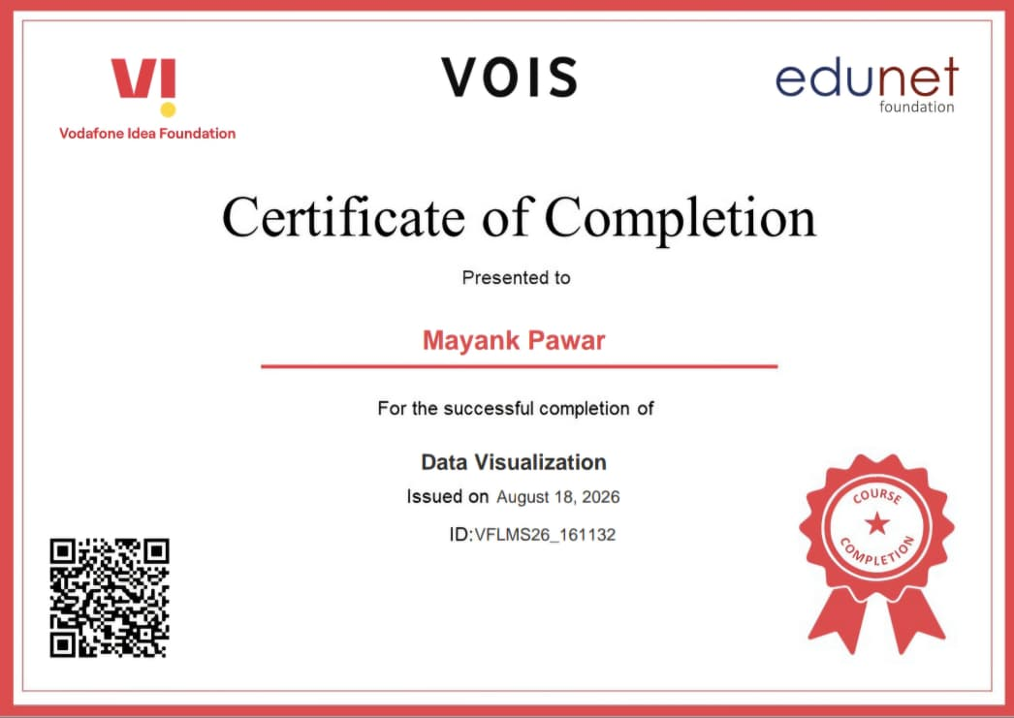
VOIS Course completion certificate - Course name- Data Visualization

Slide 14
Thank you
Presented by: Mayank Pawar
.
.

